Slide 1
How to Write Literature Review

Slide 2
Objectives
To help you understand the purpose and basic requirements of an effective literature review.
To help you critically assess research materials.
To develop strategies for inventing, organizing, and drafting a literature review.
To help you cite sources appropriately.

Slide 3
Purpose of a Literature Review
The literature review is a critical look at the existing research that is significant to the work that you are carrying out.
To provide background information
To establish importance
To demonstrate familiarity
To “carve out a space” for further research

Slide 4
Characteristics of Effective Literature Reviews
Outlining important research trends
Assessing the strengths and weaknesses of existing research
Identifying potential gaps in knowledge
Establishing a need for current and/or future research projects

Slide 5
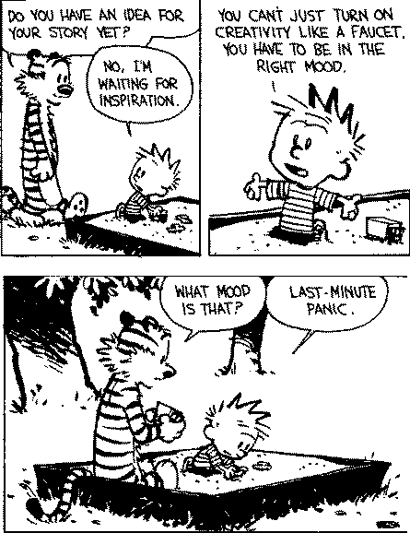
Steps for Writing a Lit Review
Planning
Reading and Research
Analyzing
Drafting
Revising

Slide 6
Planning
What Type of Literature Review
Am I Writing?
Notes:
(This slide serves as an introduction to the next four questions, about focus, type, scope and discipline).

Slide 7
Planning
Focus
What is the specific thesis, problem, or research question that my literature review helps to define?
Identifying a focus that allows you to:
Sort and categorize information
Eliminate irrelevant information
Type
What type of literature review am I conducting?
Theory; Methodology; Policy; Quantitative; Qualitative

Slide 8
Planning
Scope
What is the scope of my literature review?
What types of sources am I using?
Academic Discipline
What field(s) am I working in?

Slide 9
Reflection
Take a moment to answer each of the questions in the “Planning” section of your packet about a literature review you are currently working on or plan to work on.
How many of the questions could you answer?
What questions did this short exercise raise for you?

Slide 10
Reading and Researching
What Materials
Am I Going to Use?

Slide 11
Reading and Researching
Collect and read material.
Summarize sources.
Who is the author?
What is the author's main purpose?
What is the author’s theoretical perspective? Research methodology?
Who is the intended audience?
What is the principal point, conclusion, thesis, contention, or question?
How is the author’s position supported?
How does this study relate to other studies of the problem or topic?
What does this study add to your project?
Select only relevant books and articles.

Slide 12
Analyzing
How Do I Assess
Existing Research?

Slide 13
Analyzing Sources
A literature review is never just a list of studies—it always offers an argument about a body of research
Analysis occurs on two levels:
Individual sources
Body of research

Slide 14
Four Analysis Tasks of the Literature Review
TASKS OF
LITERATURE
REVIEW
SUMMARIZE
SYNTHESIZE
CRITIQUE
COMPARE
Notes:
As you’ll remember the four tasks of the literature review include:
Let’s look at summary and synthesis…

Slide 15
Summary and Synthesis
In your own words, summarize and/or synthesize the key findings relevant to your study.
What do we know about the immediate area?
What are the key arguments, key characteristics, key concepts or key figures?
What are the existing debates/theories?
What common methodologies are used?

Slide 16
Sample Language for Summary and Synthesis
Normadin has demonstrated…
Early work by Hausman, Schwarz, and Graves was concerned with…
Elsayed and Stern compared algorithms for handling…
Additional work by Karasawa et. al, Azadivar, and Parry et. al deals with…

Slide 17
Comparison and Critique
Evaluates the strength and weaknesses of the work:
How do the different studies relate? What is new, different, or controversial?
What views need further testing?
What evidence is lacking, inconclusive, contradicting, or too limited?
What research designs or methods seem unsatisfactory?

Slide 18
Sample Language for Comparison and Critique
In this ambitious but flawed study, Jones and Wang…
These general results, reflecting the stochastic nature of the flow of goods, are similar to those reported by Rosenblatt and Roll…

Slide 19
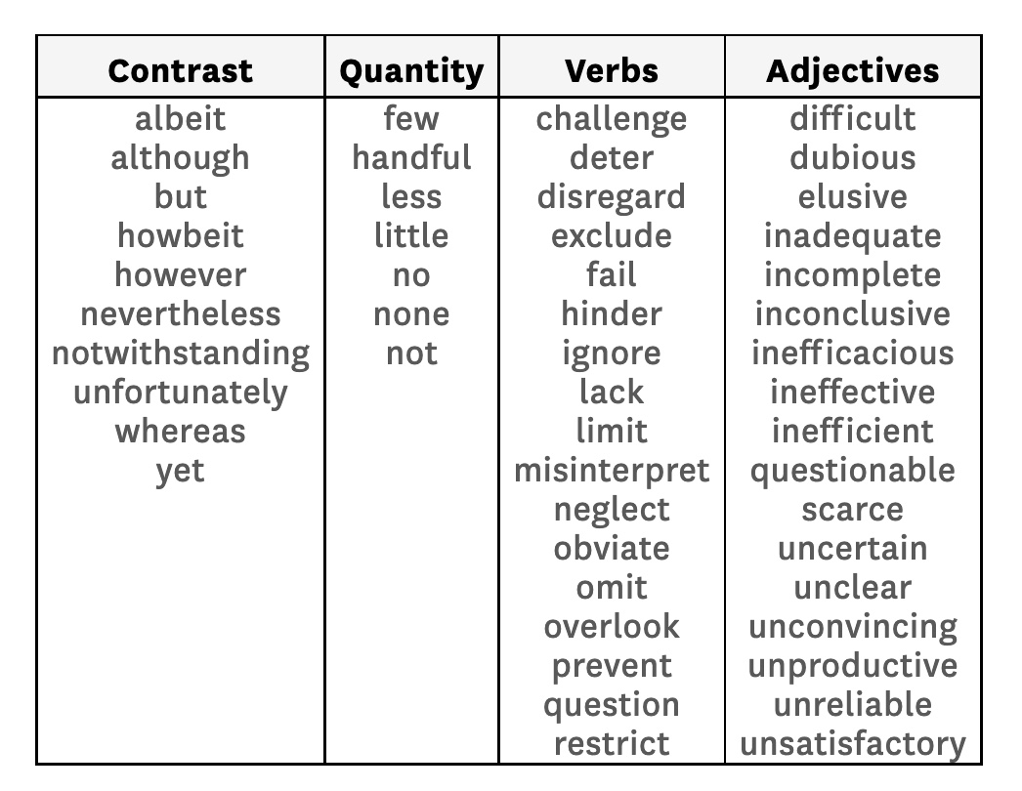
Evaluative Adjectives
Unusual
Small
Simple
Exploratory
Limited
Restricted
Flawed
Complex
Competent
Important
Innovative
Impressive
Useful
Careful
Notes:
As you write, you’ll want to utilize evaluate words to articulate your critique. Some possibilities include…
Now, let’s return to the central questions of a literature review

Slide 20
Drafting: Putting It All Together
Once you have summarized, synthesized, compared, and critiqued your chosen material, you may consider whether these studies
Demonstrate the topic’s chronological development.
Show different approaches to the problem.
Show an ongoing debate.
Center on a “seminal” study or studies.
Demonstrate a “paradigm shift.”

Slide 21
Putting It All Together
What do researchers KNOW about this field?
What do researchers NOT KNOW?
Why should we (further) study this topic?
What will my study contribute?

Slide 22
Revising: Citing Sources
If it’s not your own idea (and not common knowledge)—DOCUMENT IT!
Paraphrase key ideas.
Use quotations sparingly.
Introduce quotations effectively.
Use proper in-text citation to document the source of ideas.
Maintain accurate bibliographic records.

Slide 23
Citing Sources: Things to Avoid
Plagiarism
Not Enough Citations.
Citation Frequency in Summaries
Incorrect Paraphrasing
Lack of Quotation Marks

Slide 24
Writing an Introduction
Three Questions-Three Paragraphs
What is the reality-Background
Why this study – Information on your topic
How this study will proceeds- presents a clear thesis statement

